Slide 1

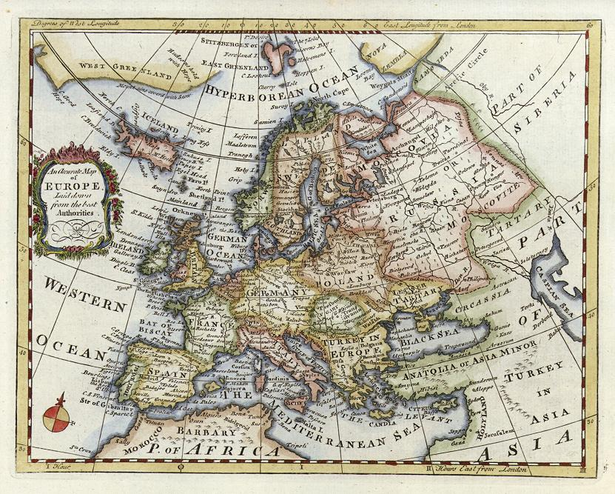
AP Euro Review: Semester I
It is time to work, lets go!

Slide 2

Art Section
Italian Renaissance
Northern Renaissance
Mannerism
Italian Baroque
Dutch Baroque

Slide 3

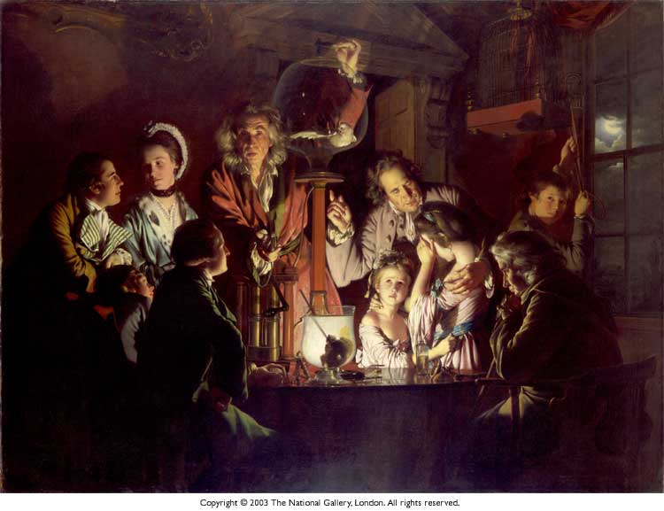
Quote Section
Galileo, Kepler, Copernicus, Newton, Descartes, Hobbes, Rousseau, Voltaire, Montesquieu, Kant

Slide 4
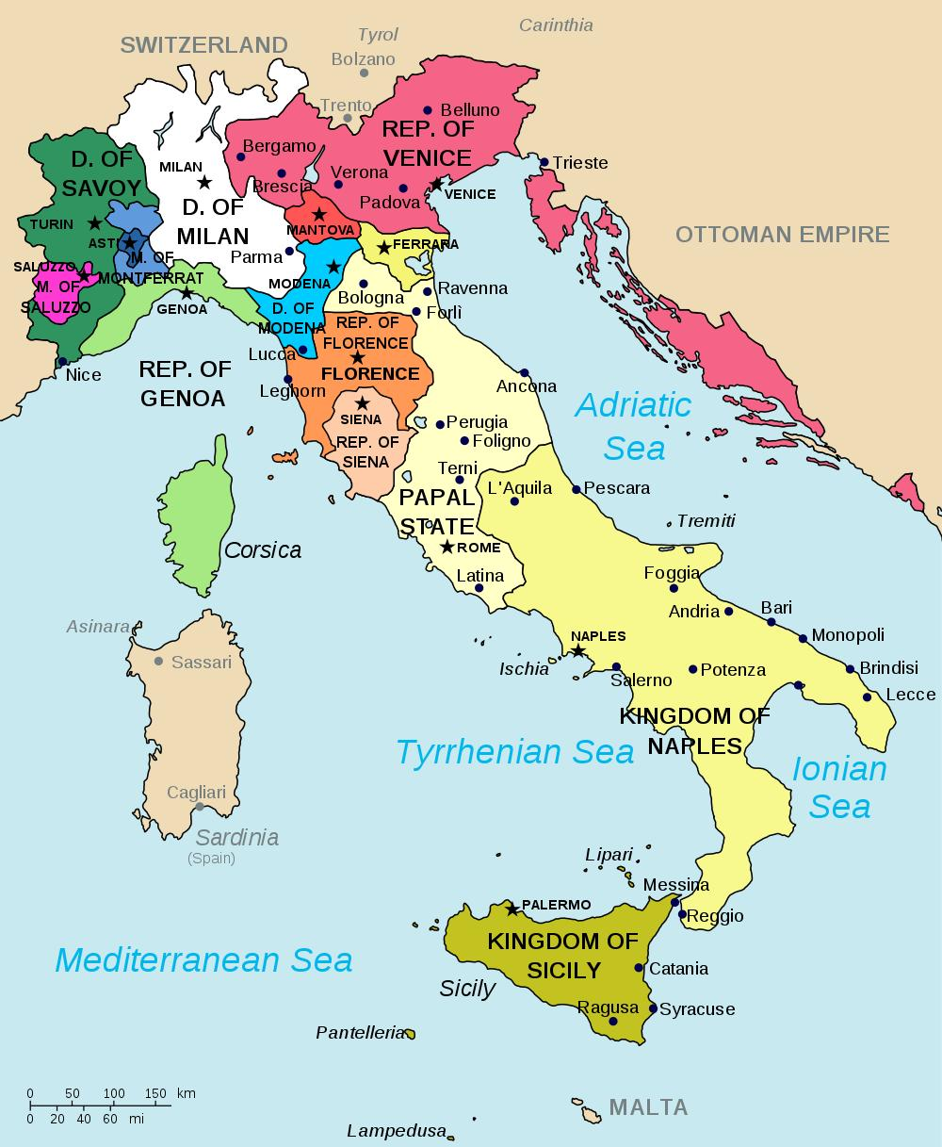
Renaissance
City – States – These were how the 15th century Italian towns were organized.
Major City States
Republic of Florence
Republic of genoa
Duchy of Milan
Rome, the Papal States
Naples, Kingdom of Two Sicilies
Venice, Venetian Republic

Slide 5
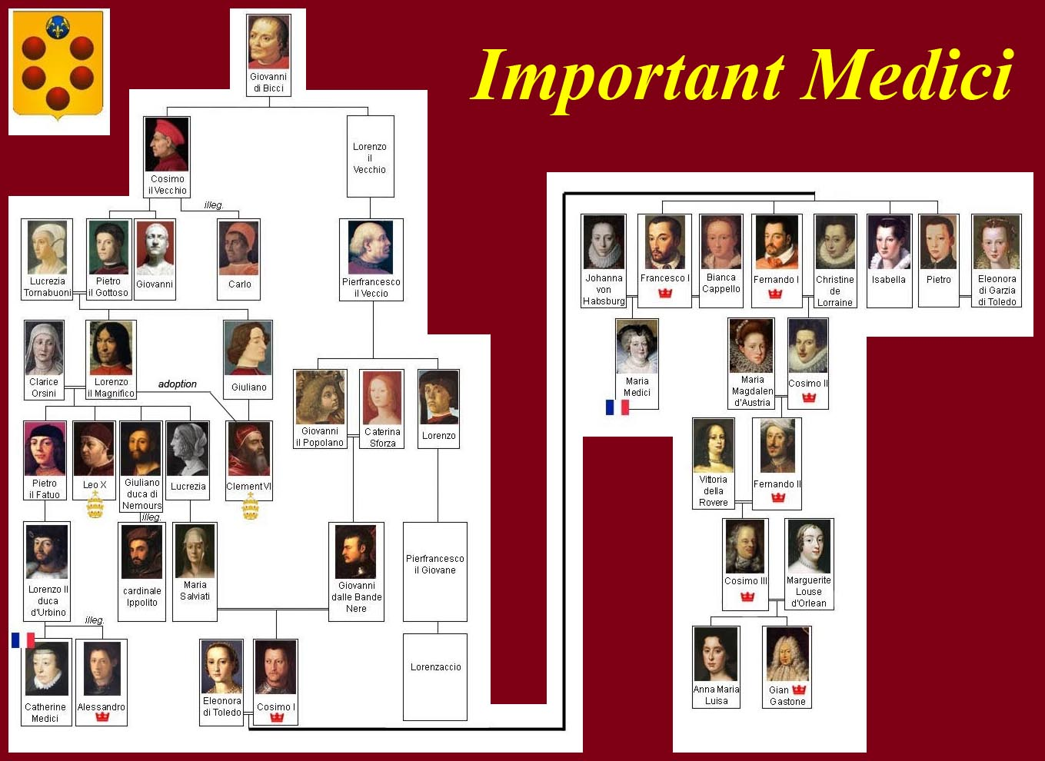

Slide 6
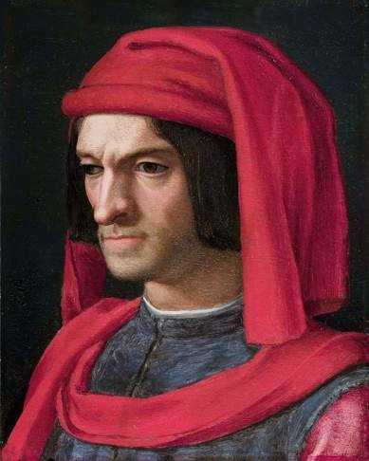
Renaissance
The most famous dynasty of merchants and bankers was the Medici Family. They ruled city-states and commissioned many pieces of art.
Lorenzo the Magnificent – Republic’s ruler and patron of arts. Personified Renaissance, living life rather then waiting for death.

Slide 7
Renaissance
The Renaissance, being a hub for trade shared many ideas with the world, like Arab Mathematics and technology, and Asian products.
Humanism: This literary movement that was in contrast with the late middle ages. It focused on classical antiquity. They wrote in Italian rather than Latin, creating Europe’s first vernacular language. Writing in Vernacular helped with national identities.

Slide 8

Renaissance
Humanism focused more on human experiences, manner, politics. Along with individualism, it was somewhat of a deviation from religion.

Slide 9
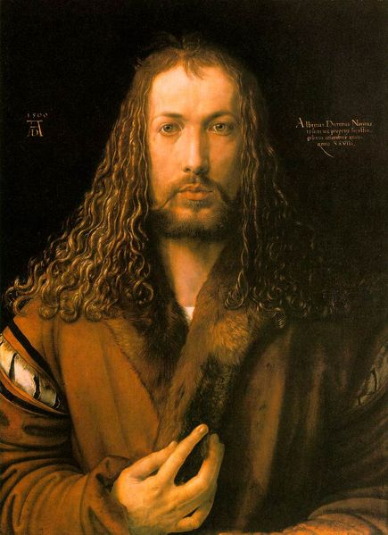
Renaissance
Renaissance (14th – 17th century) took place in the Italian City-States because of their control of trade. They became the middle-men of Europe and was resulted was a rising middle class who became patron of the arts.
Renaissance WASN’T a rebirth in law, government or economic production, it is still medieval.

Slide 10
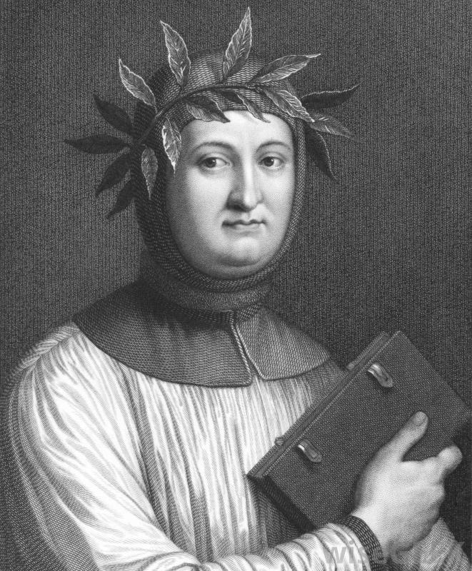
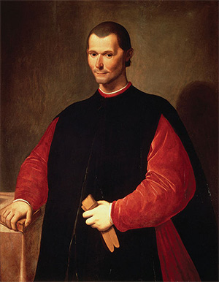
Renaissance
Petrarch – First “modern” writer, wrote in both Italian and Latin.
Niccolo Machiavelli – Founder of political science, wrote “The Prince.” Governments should rule without moral judgment.

Slide 11
Renaissance
Christian Humanism was created in the Northern Renaissance basing their knowledge of Hebrews and Greek text of the bible (Italian Renaissance focused on earlier Pagan text)
Civic Humanism: Modeled on Cicero, the belief that it was an intellectual's civic duty to be involved in politics and help the community.

Slide 12
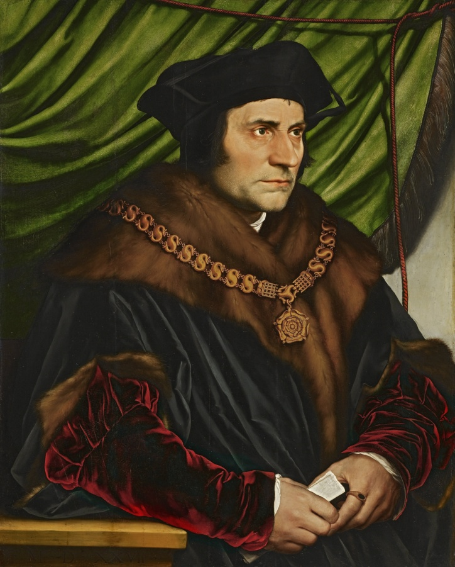
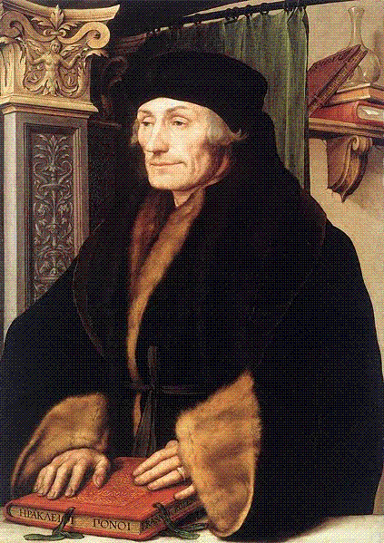
Renaissance
Erasmus: Translated New Testament into Greek. Wrote the “Praise of Folly,” enemy of Luther wanted to reform Catholic Church.
Thomas More – Wrote Utopia, opposed Henry VIII break from Catholic Church was beheaded for principles.

Slide 13
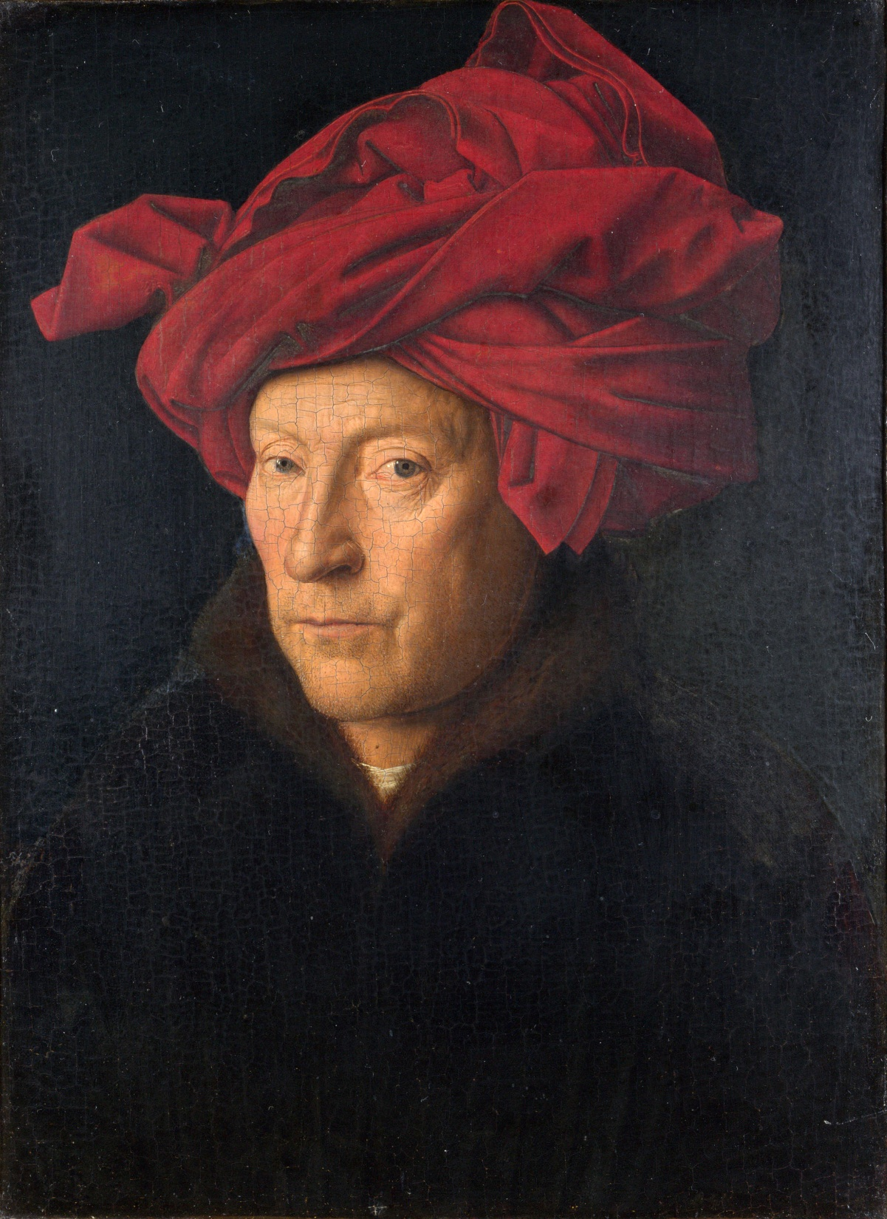
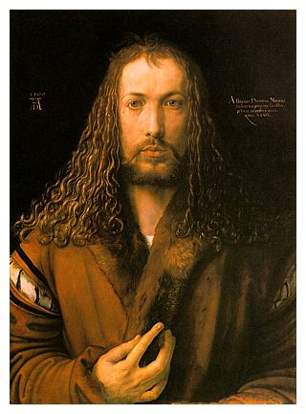

Slide 14

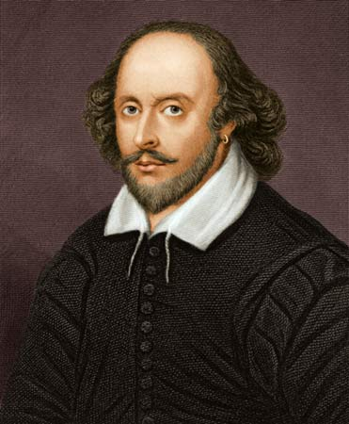
Renaissance
Miguel de Cervantes: Wrote Don Quixote
William Shakespeare : Wrote several playwrights: Hamlet, Julius Caesar, Romeo or Juliet

Slide 15
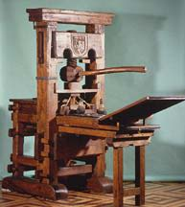
Renaissance
The printing press was popularized by Johannes Guttenberg, actually invented in China but Guttenberg first to make interchangeable type.
Books became cheaper, more people read, it allowed the Bible to be created in vernacular languages for the laity (non religious to read themselves).

Slide 16
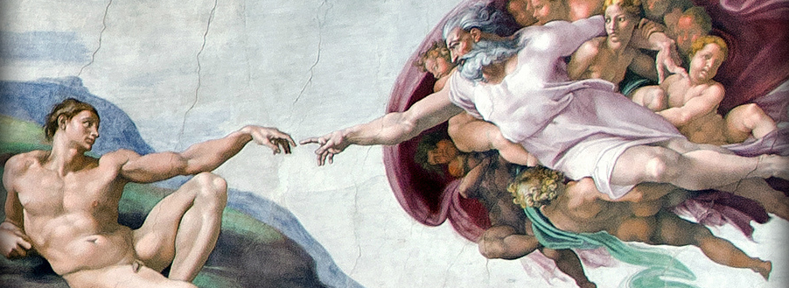
Renaissance
Secularism – Became more common in the cities and art, BUT the Renaissance DID NOT abandon interest in religion. The greatest patron of arts was the Church.

Slide 17
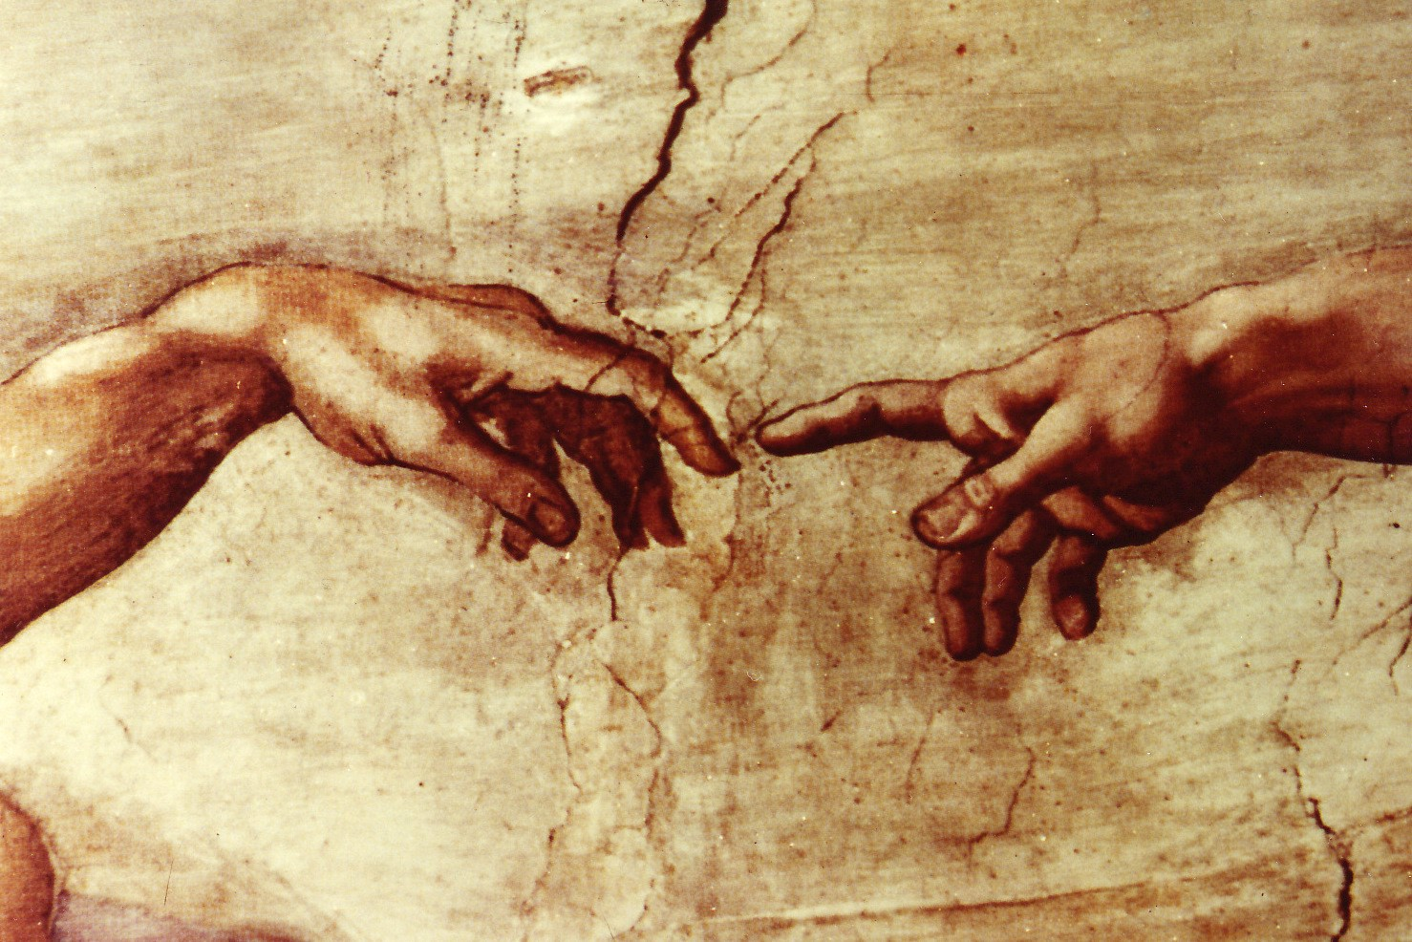

Slide 18
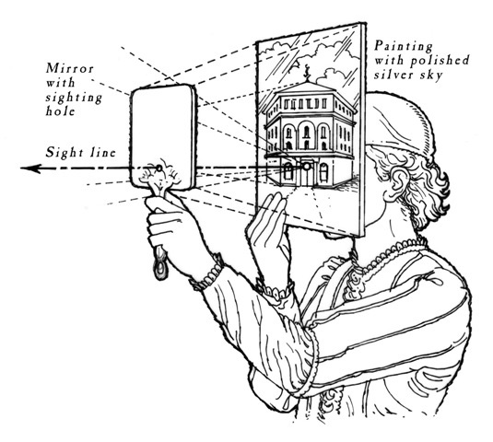
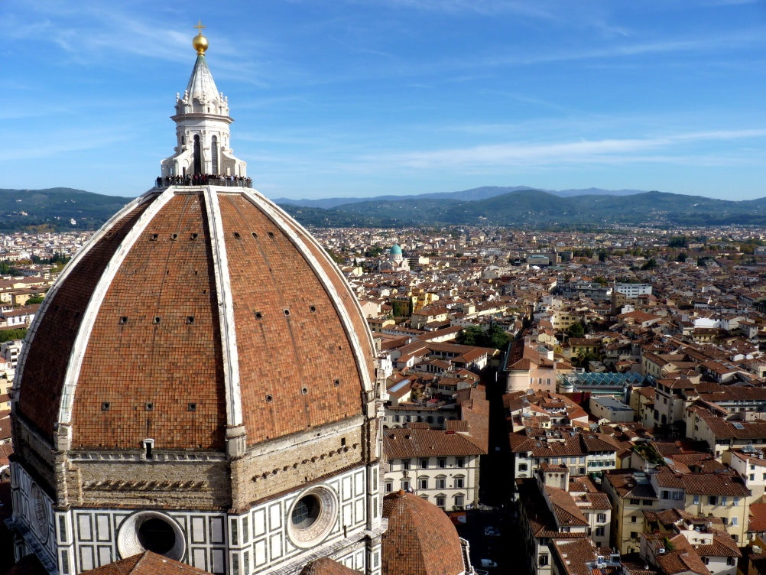
Renaissance
Renaissance art was a large focus of the movement.
Brunelleschi – linear perspective

Slide 19
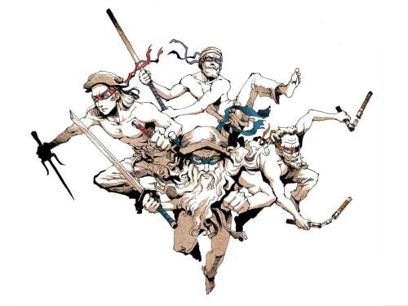

Slide 20
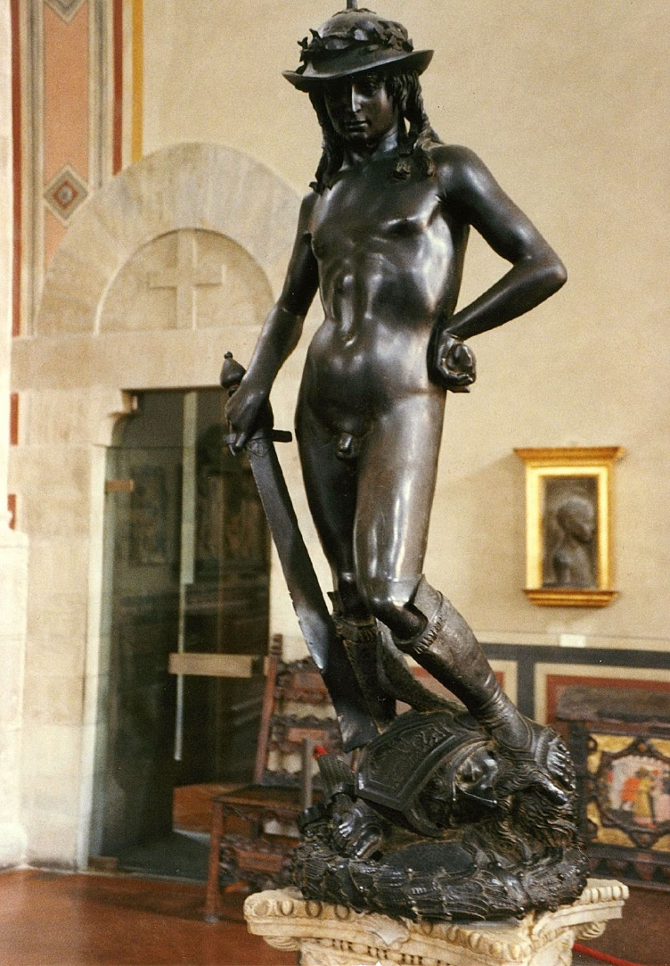
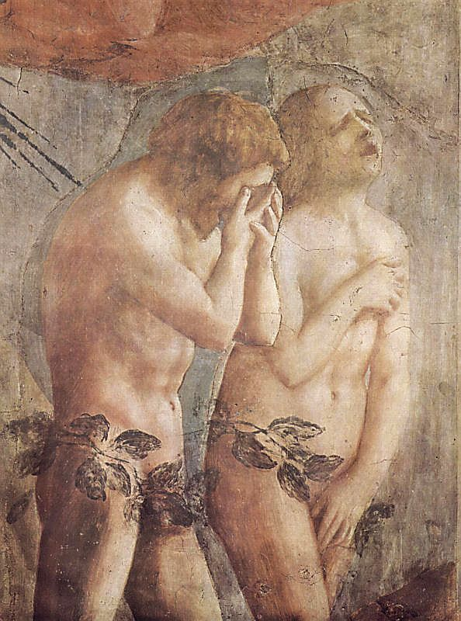
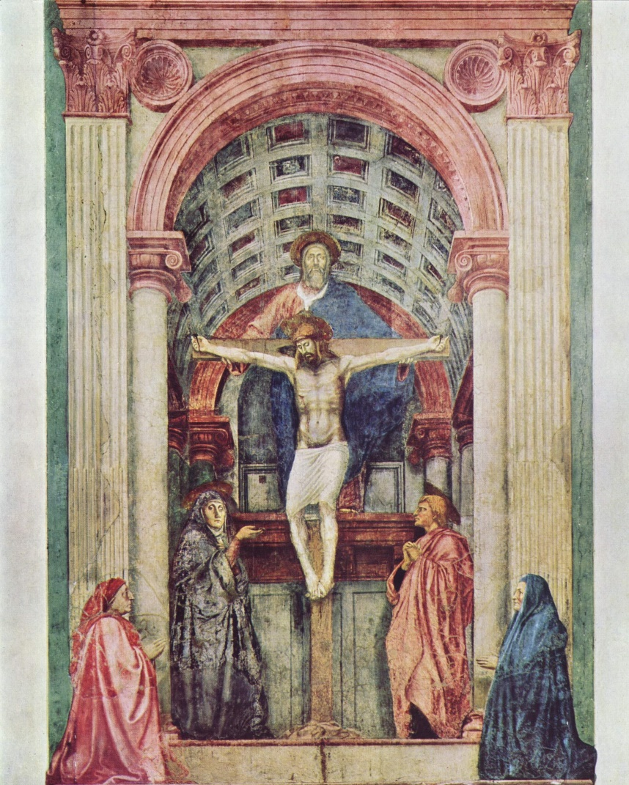
Renaissance
Donatello
Masaccio

Slide 21
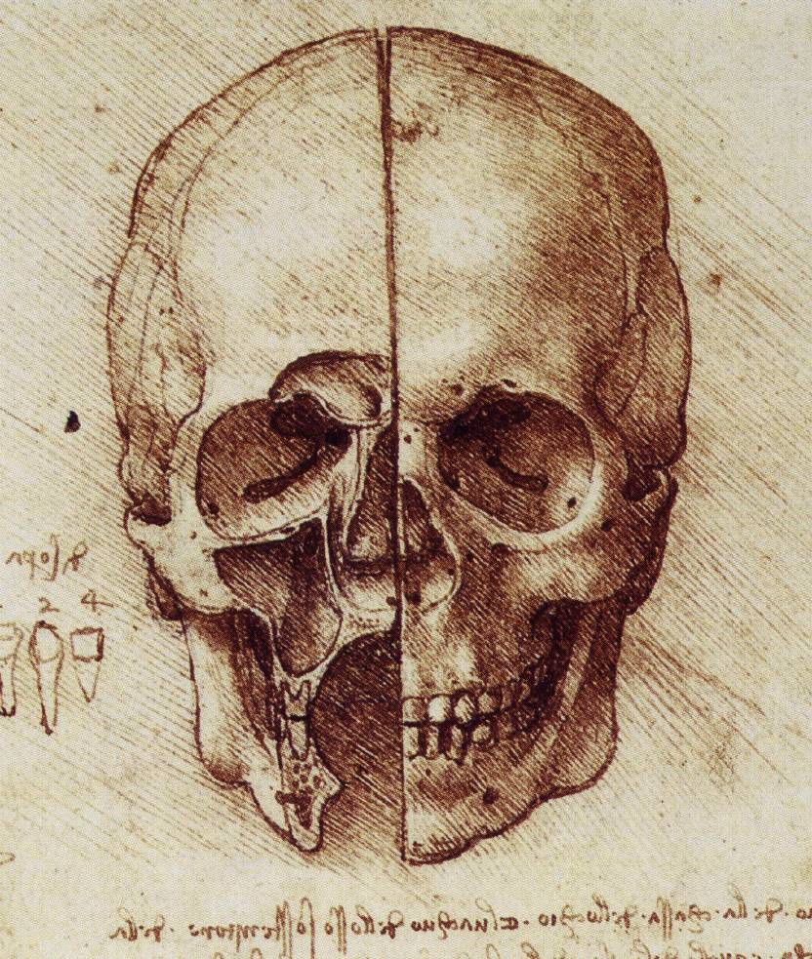
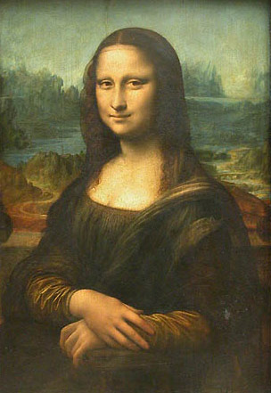
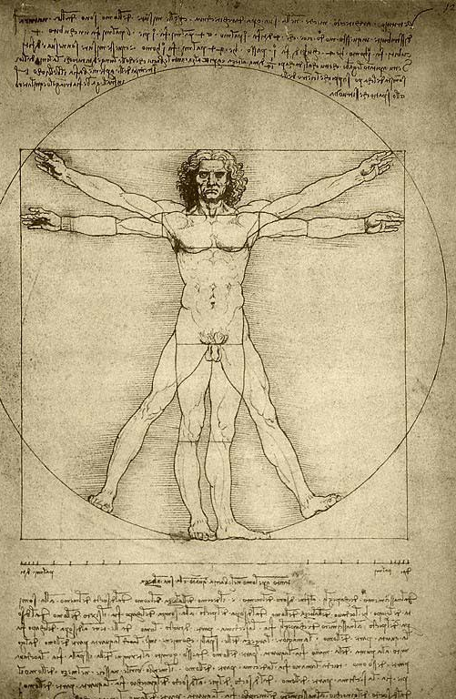
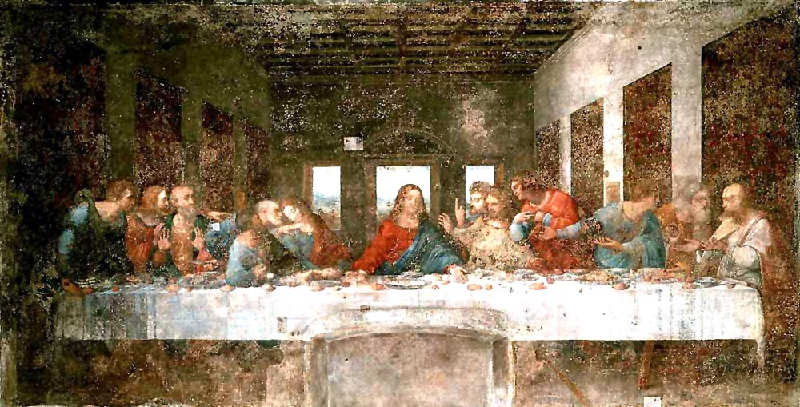
Renaissance
Leonardo da Vinci

Slide 22
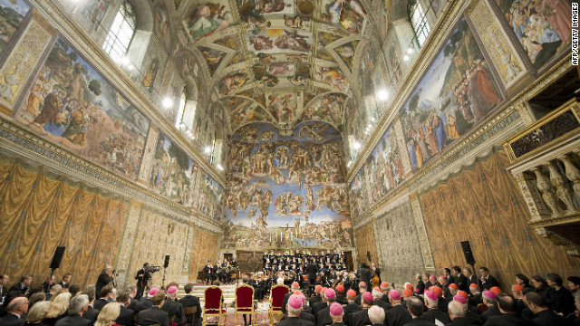
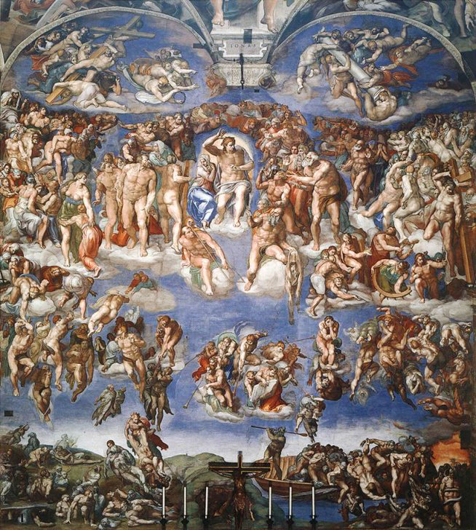
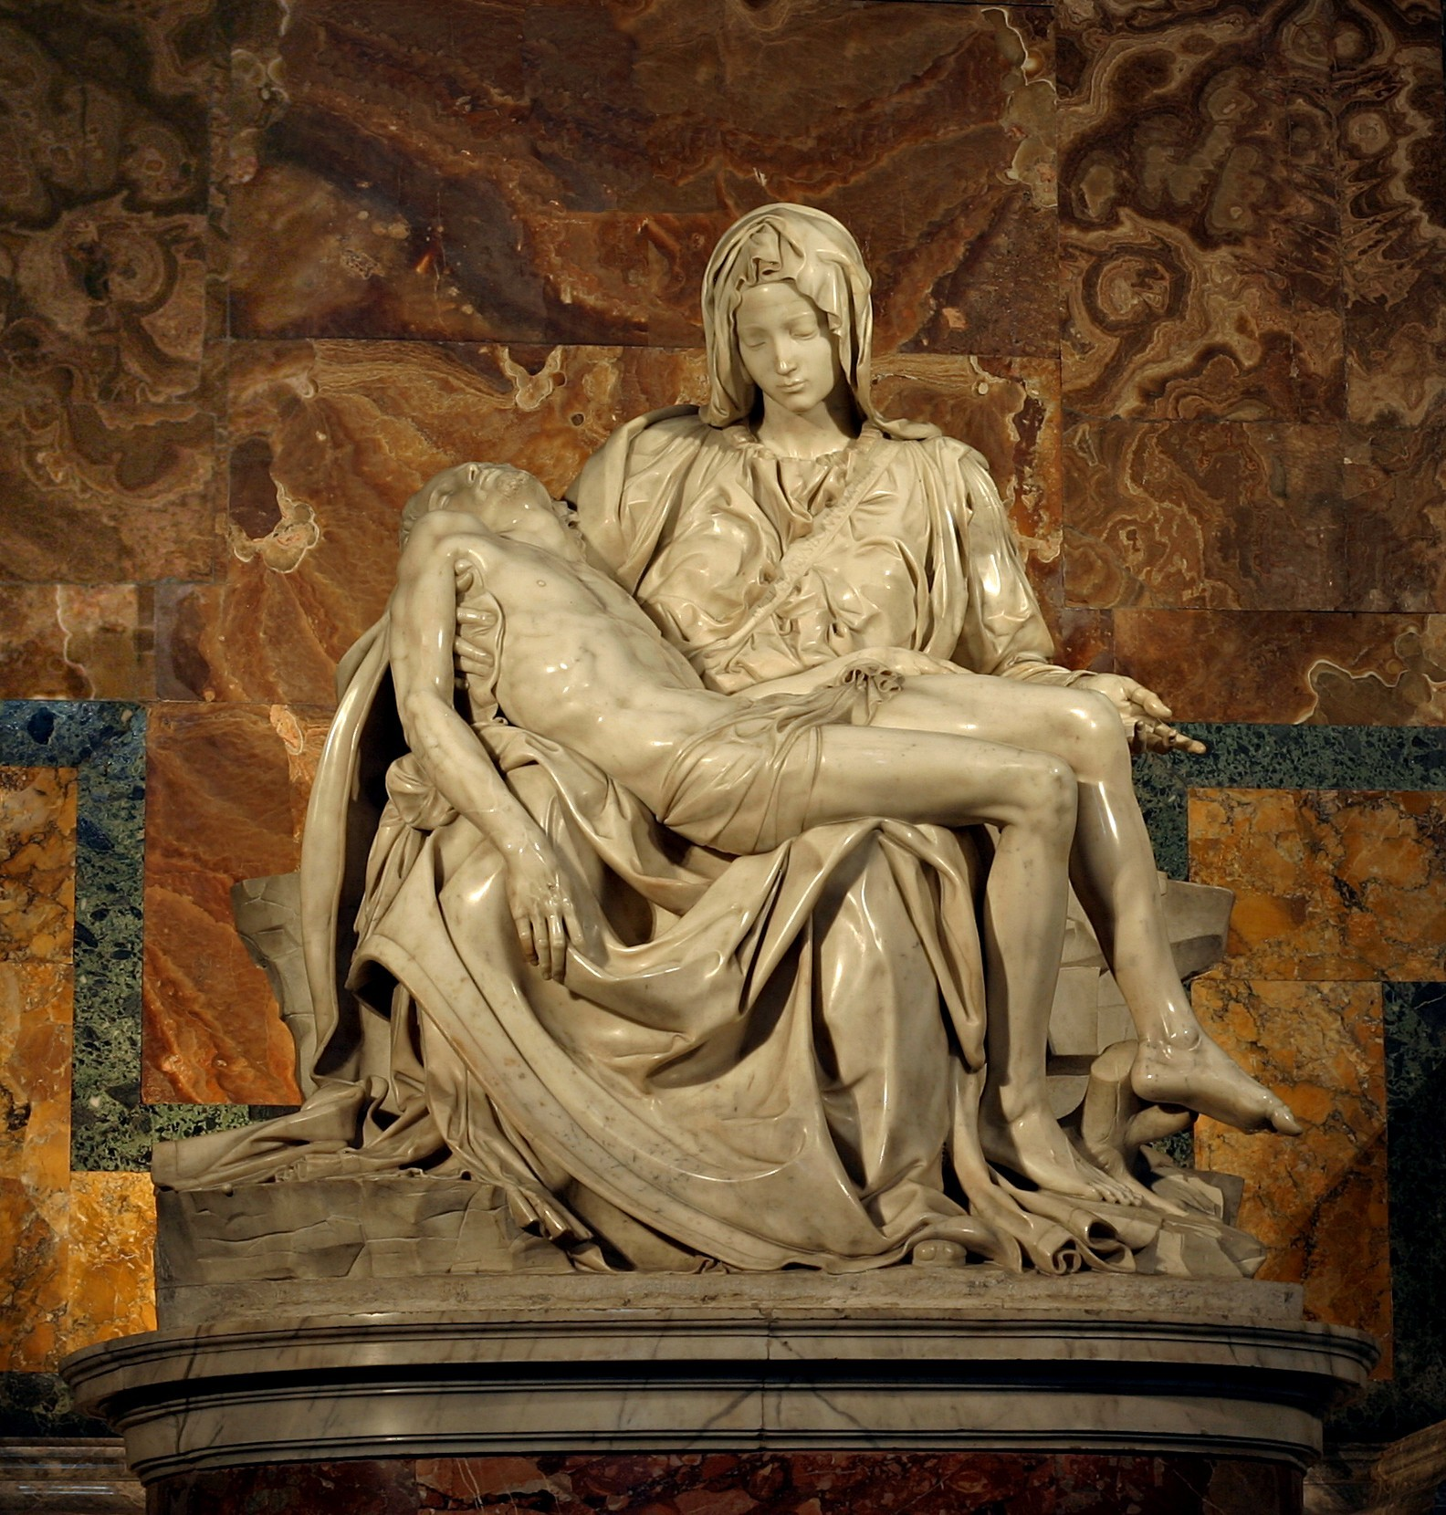
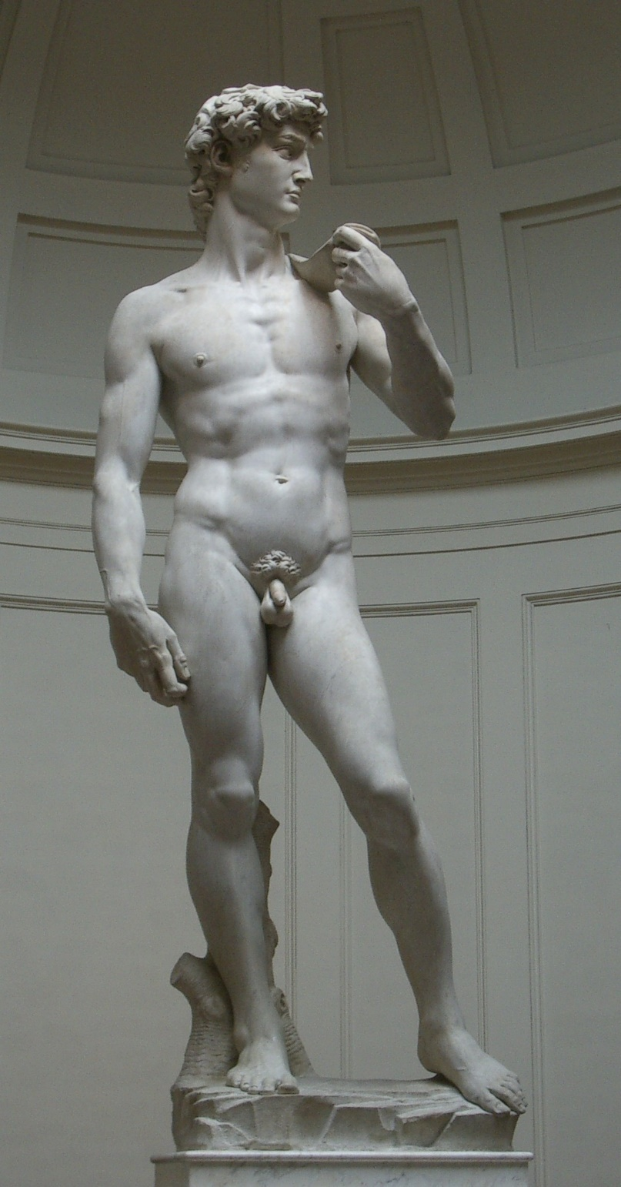
Renaissance
Michaelaneglo

Slide 23
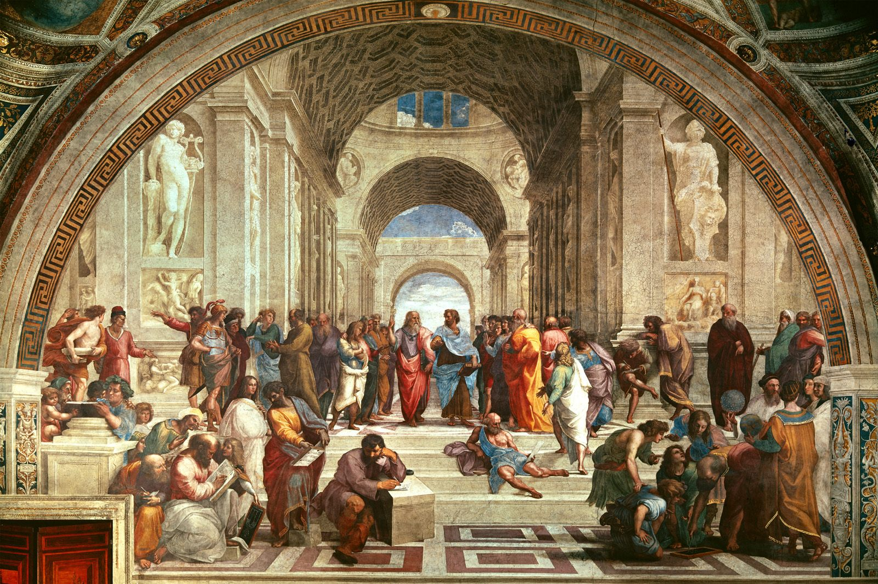
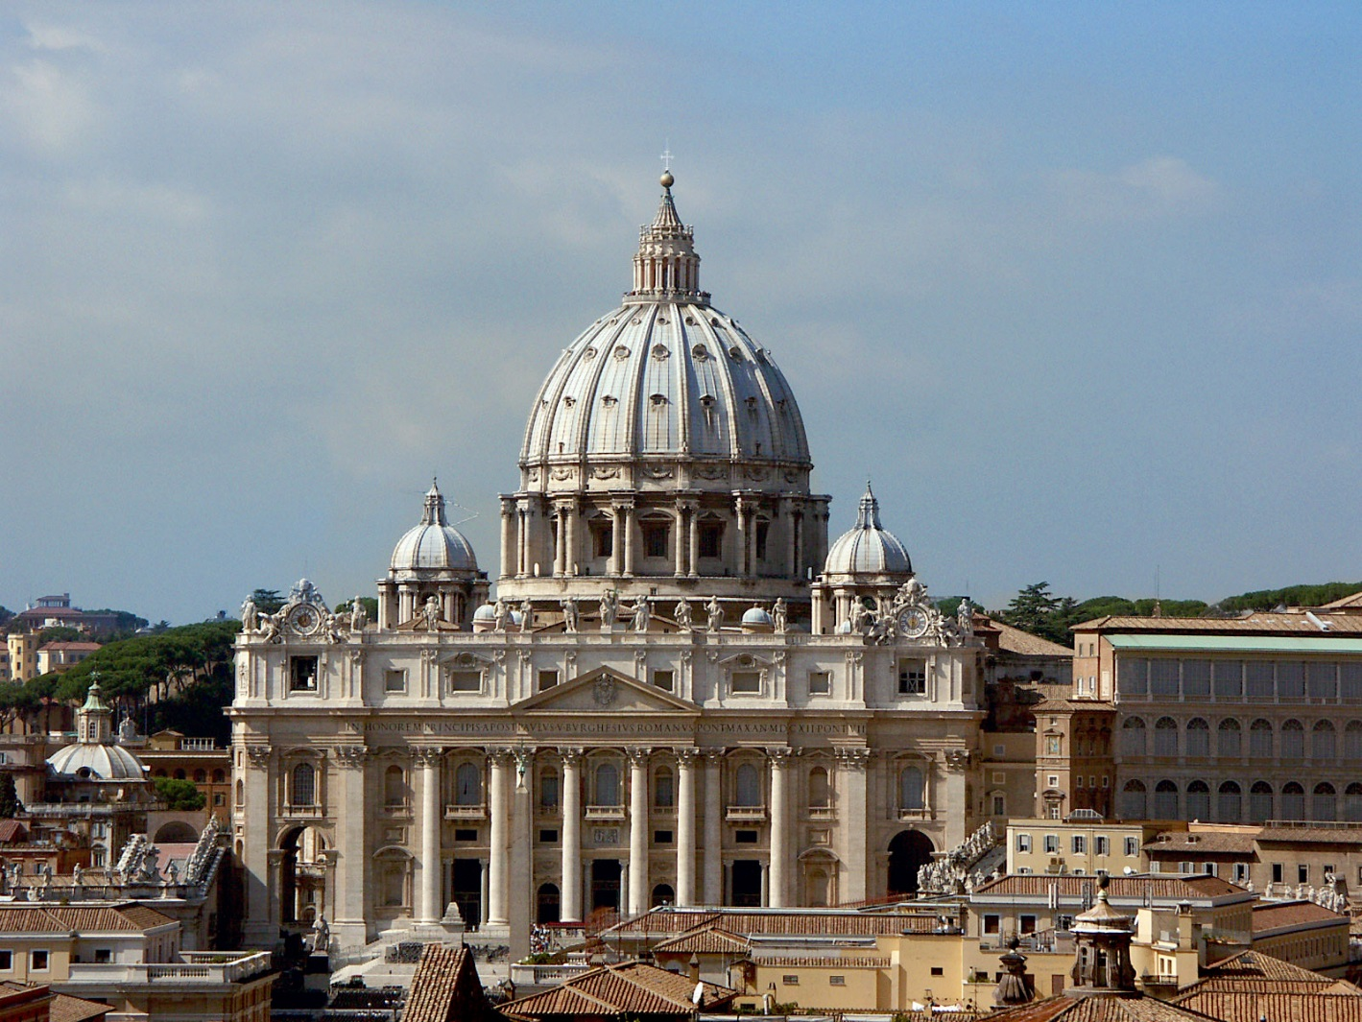
Renaissance
Raphael Sanzio

Slide 24
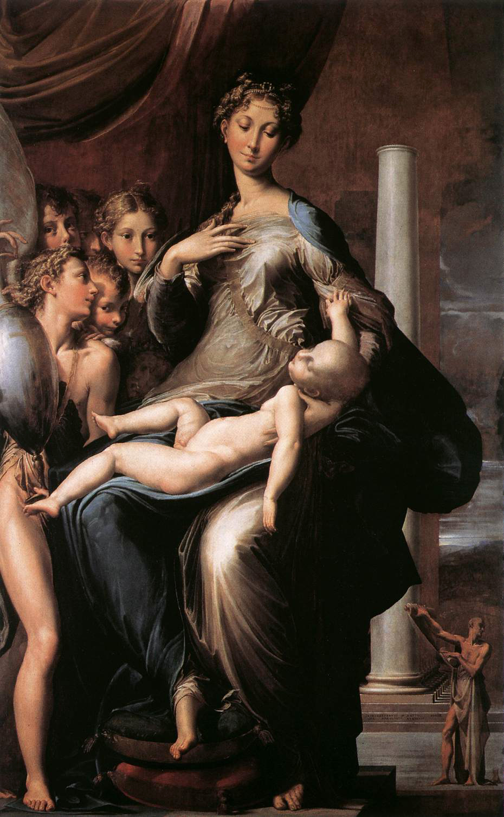
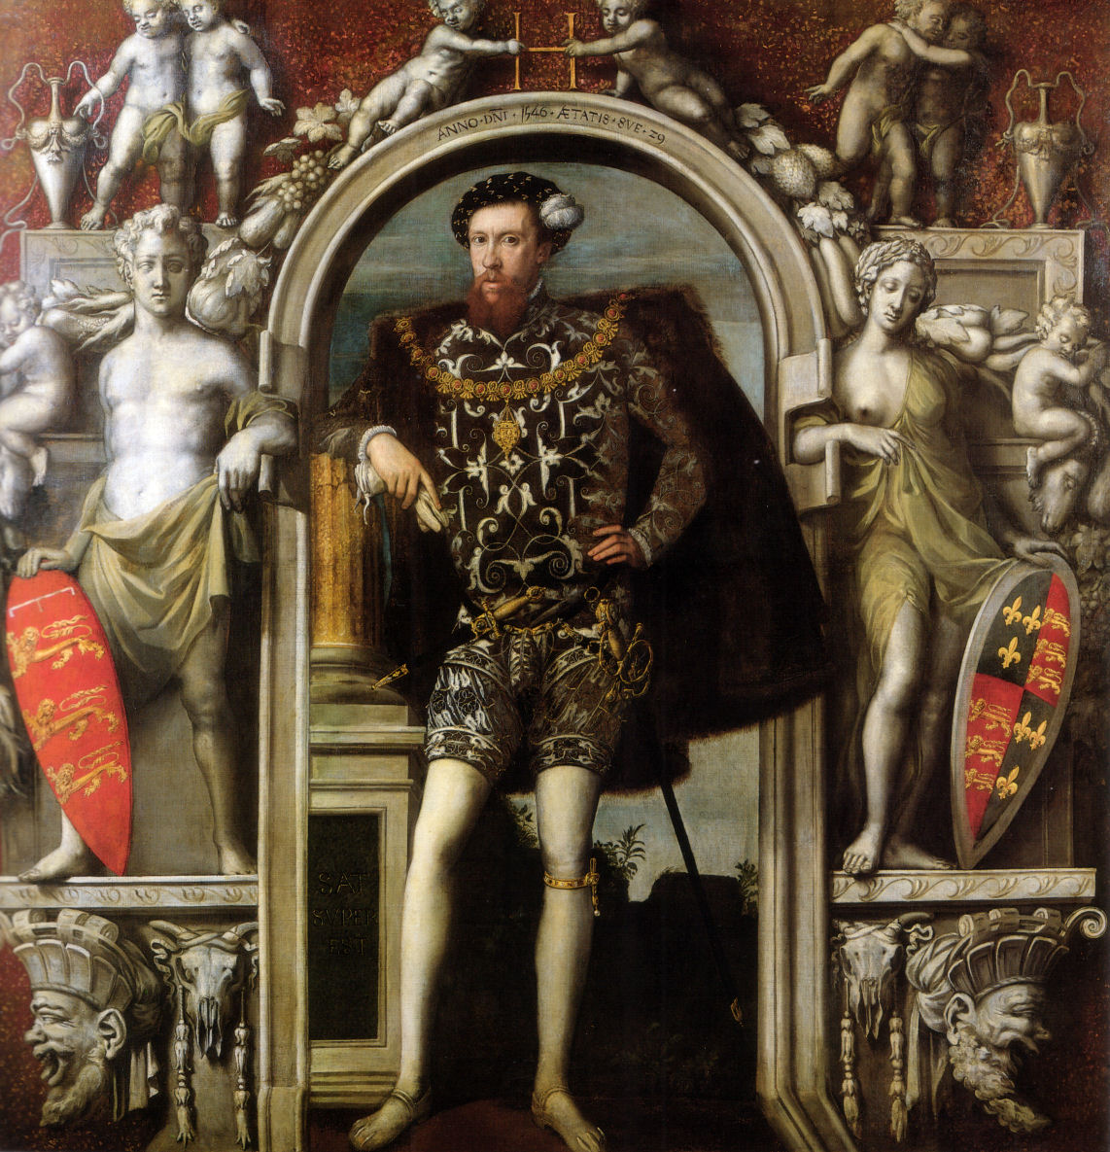
Mannerism

Slide 25

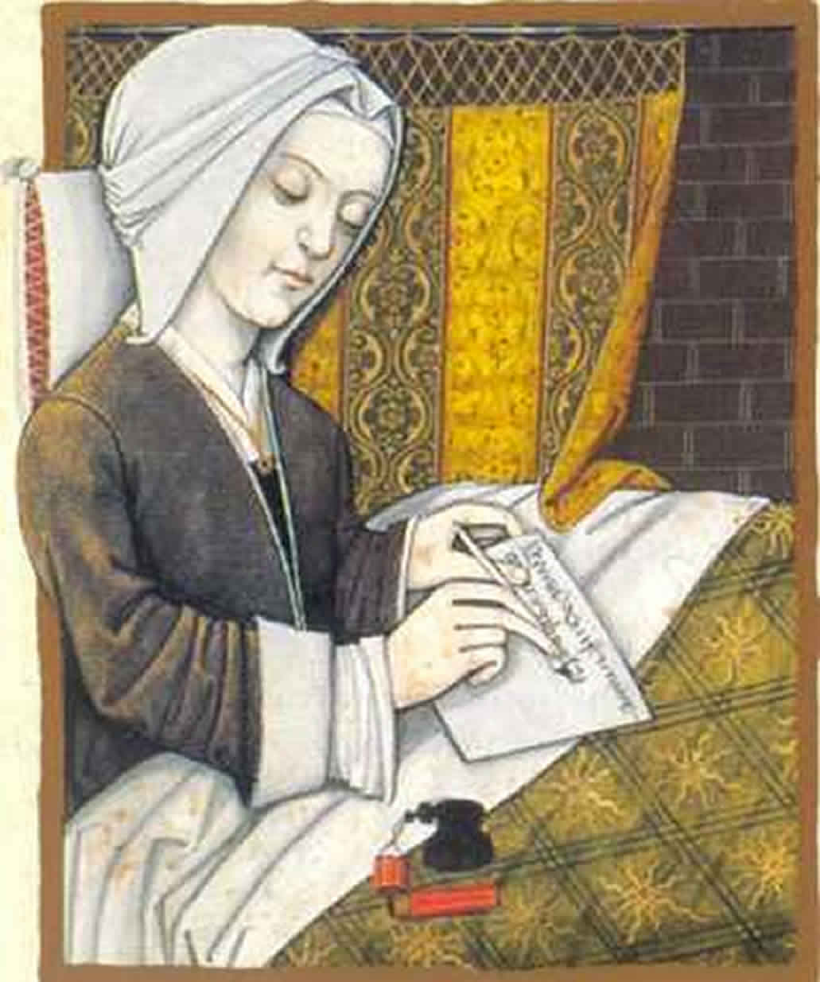
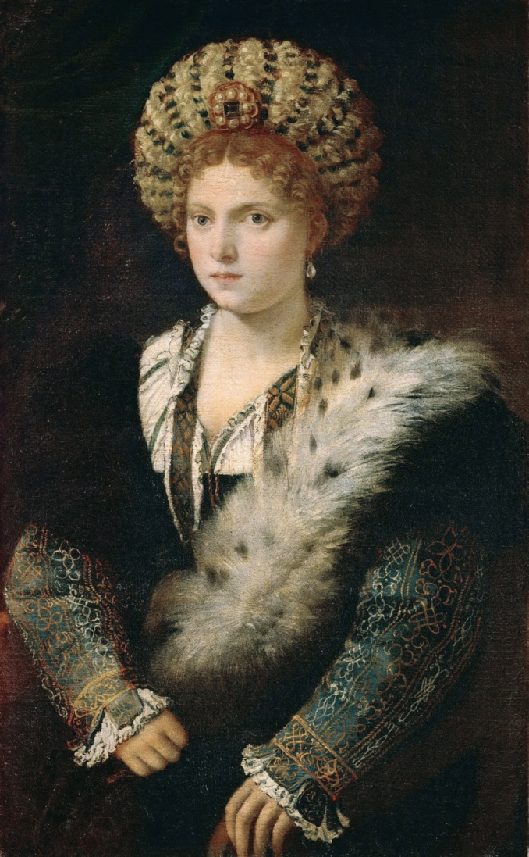
Renaissance View of Women
Christina Pizan
Isabella d’Este

Slide 26
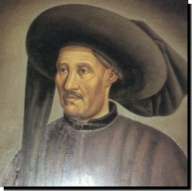
Portugal Leads the Way
One leading country in developing early exploration was Portugal.
They were able to do this by strong support by their government, led by Prince Henry (Henry the Navigator) son of Portugal’s King.
They also were competing with Spain for influence and power.

Slide 27
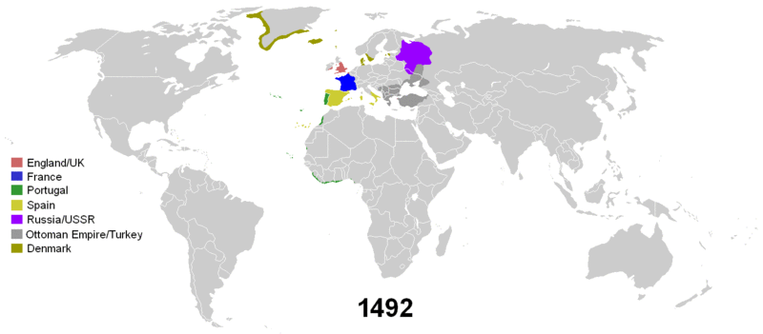
History of Colonialism

Slide 28
European Exploration
God Glory and Gold mainly led the European explorers to search out territories in the new world, in Africa and in Asia.
The theory of mercantilism was the idea behind maximizing your exports and gain precious metals to enable the state to defend itself.

Slide 29
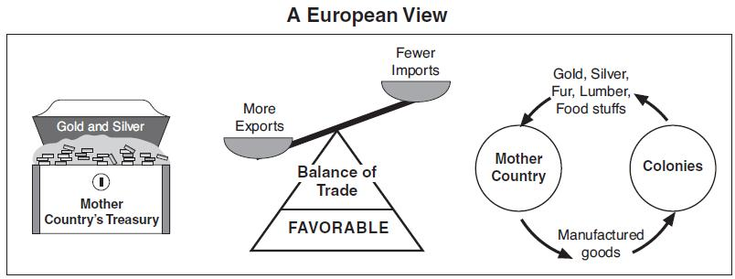

Slide 30
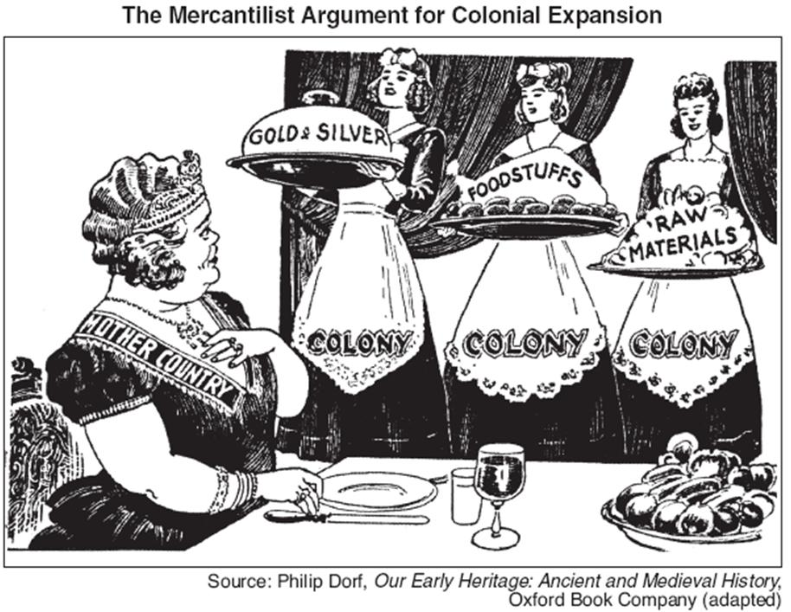

Slide 31
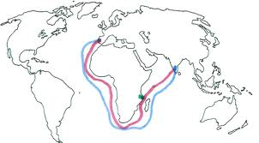

Slide 32
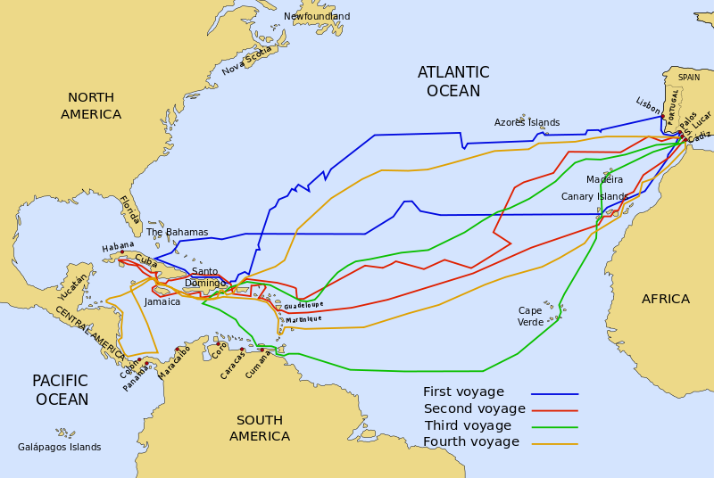

Slide 33
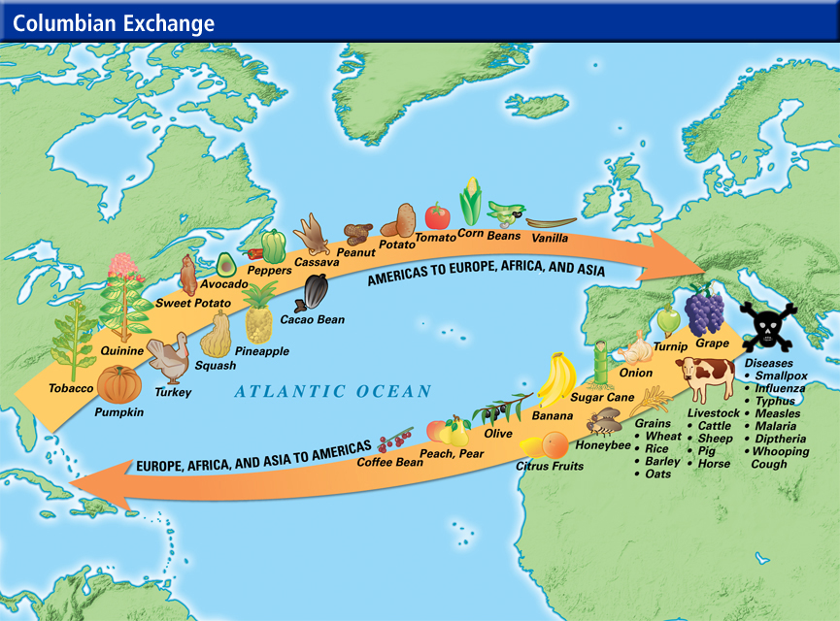

Slide 34
Commercial Revolution
Commercial Revolution: was a period of European economic expansion, colonialism, and mercantilism which lasted from approximately the 16th century until the early 18th century.
It was succeeded in the mid-18th century by the Industrial Revolution.
The Commercial Revolution is marked by an increase in general commerce, and in the growth of non-manufacturing pursuits, such as banking, insurance, and investing.

Slide 35

Beginning in the 1600’s
The English and Dutch began to challenge Portugal’s rise in the Indian Ocean trade.
The Dutch East India company controlled Indian Ocean trade in the 1600’s.

Slide 36


Slide 37
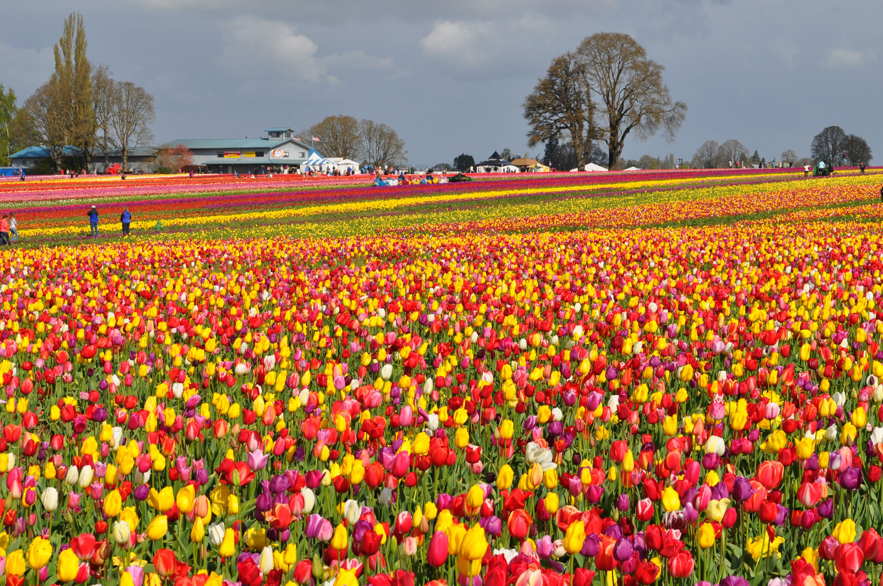

Slide 38


Slide 39
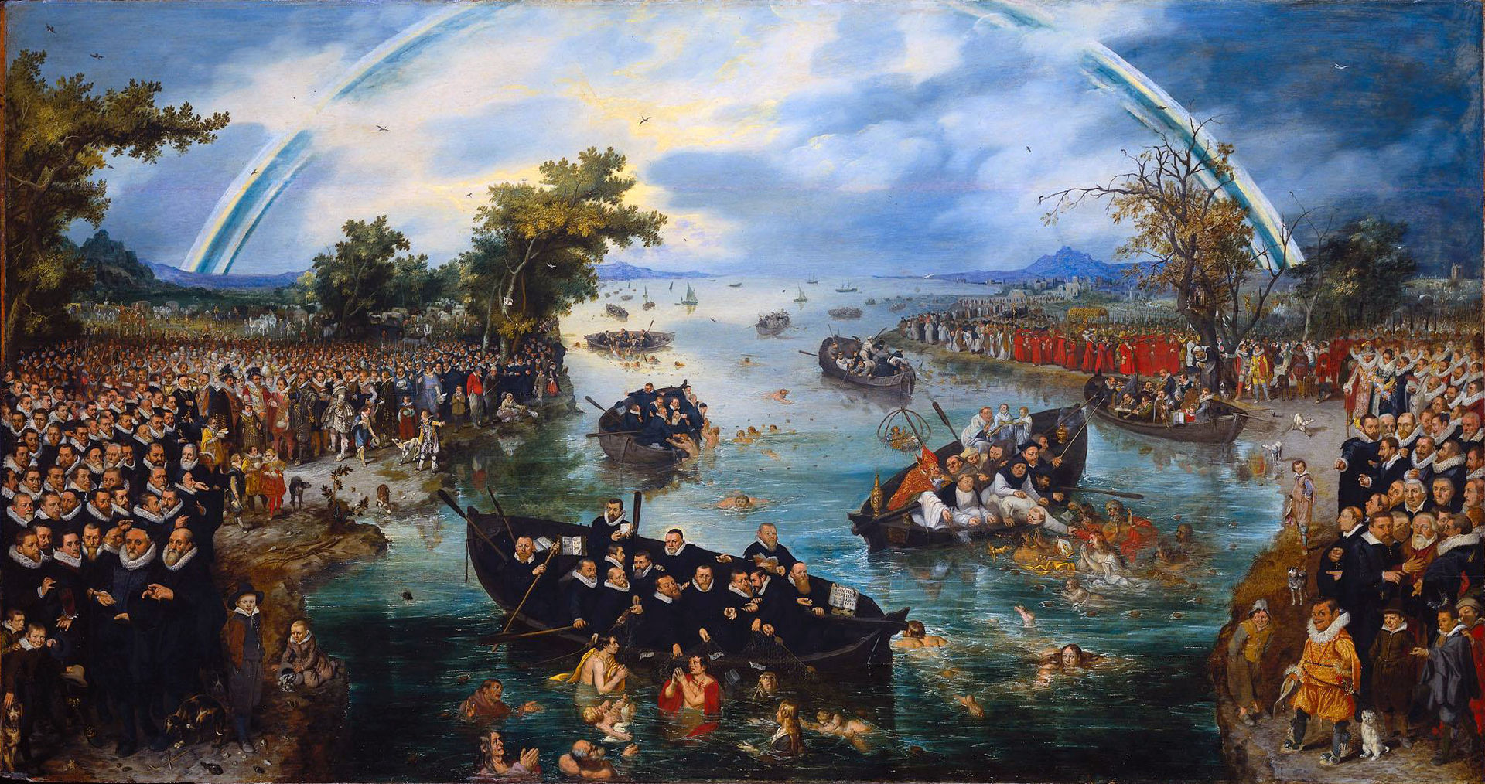
Adriaen van de Venne“ Fishing For Souls”

Slide 40
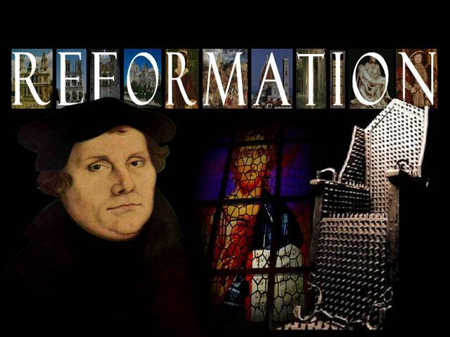

Slide 41
Religion
The Protestant Reformation marks the beginning of modern Europe. It was an attempt to reform the Catholic Church, what happened was very different.

Slide 42
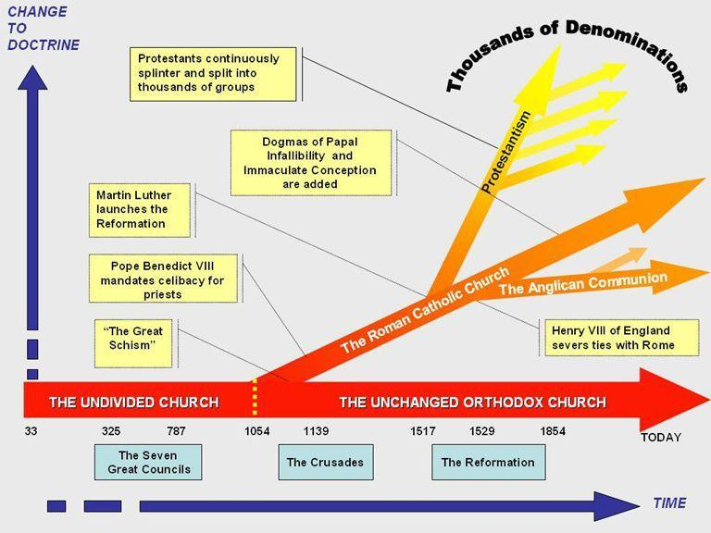

Slide 43
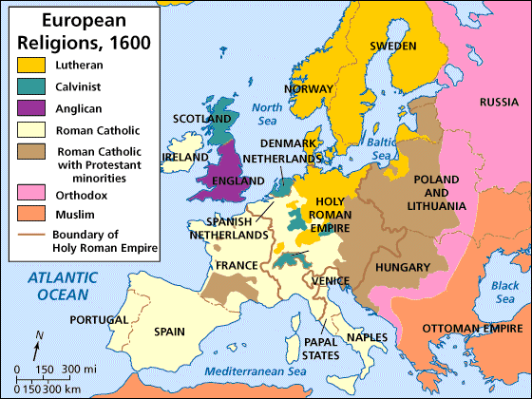

Slide 44
Causes of the Reformation
Corruption of the catholic Church (indulgences, simony [sale of church officers], decline of morality)
Impact of Renaissance humanism
Catholic Church losing prestige: Babylonian captivity (Popes moving to Avignon, because they were subservient to king AND Great Schism of 1378, elected two popes and for a brief time had three.
Religious reformers who stress personal connection with God, diminished sacraments and influence of clergy
Power struggle between secular rulers (Kings) and popes.
Invention of printing press, spread ideas (especially translations of the Bible)

Slide 45
Seven Sacraments
Catholic Church Teachings
Baptism
Confirmation
Communion (Eucharist)
Confession (Penance)
Marriage
Anointing the Sick (Last Rites)
Ordination
Lutheranism
Baptism
Communion

Slide 46
Ways to Get to Heaven
Catholic Church
Through your faith in God
AND
Through your good works.
Luther’s Views
Through your faith alone
St. Paul said. “The just shall live by faith” Romans 1:17

Slide 47
Understanding the Word of God
Catholic View
Church explained the Bible to the people.
Indirect relationship with God. Relationship through Pope.
Luther’s Views
On scripture alone you learn and interpret God’s will. (translated Bible)
Direct relationship with God.

Slide 48
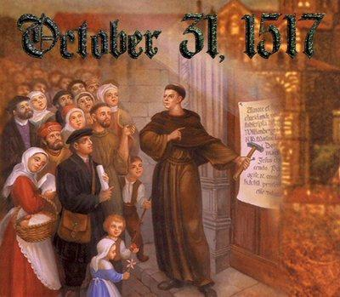
German Martin Luther
Posted the 95 Theses

Slide 49
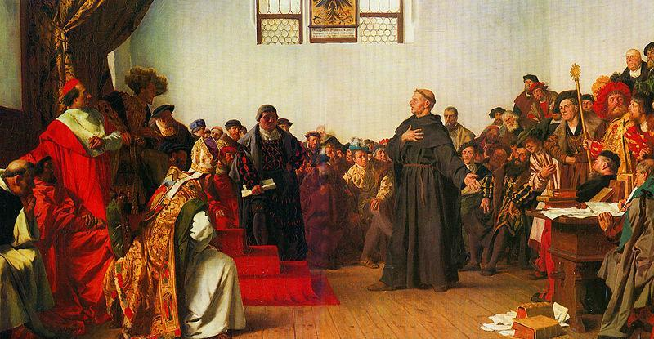
I am bound by the scriptures…I cannot and will not recant anything.”

Slide 50

Religion
Pope Leo X was the pope during Martin Luther’s posting of the 95 theses.
Pope Leo X issued a Papal Bull (Church law) that he recant, Luther burned it up.
Holy Roman Emperor Charles X issued a debate.

Slide 51
Religion
As Lutheranism spread throughout Germany, Scandinavia German peasants revolted against manorialism (medieval feudalism).
This was known as the Peasants War (1524 – 1526)
Luther’s response: Against the Murderous, Thieving Hordes of Peasants

Slide 52

Religious Pluralism

Slide 53


Slide 54
Calvinism
John Calvin published Institutes of the Christian Religion in Switzerland in 1536.
He focused on two big ideas:
Predestination: God already knows who is saved, you cannot “win” salvation
Church Government: Replaced church hierarchy with a democratic system, every congregation would pick their minister.

Slide 55

Eucharist
Luther- the bread and the wine are really the Body and the Blood of Jesus Christ, given for the remission of sins.
Calvin- Christ is spiritually present in the bread and the wind.
Zwingli- the bread and the wine are only symbolic and consumed as a memorial for Jesus Christ.

Slide 56

Anabaptists

Slide 57
English Reformation
Originally called by “Defender of Faith” by Pope Leo X after he defended the seven sacraments.
Then Parliament passed the Act of Supremacy. So what happened?
Act of Supremacy: declared Henry, “the only supreme head in earth of the Church of England.”
1534

Slide 58


Slide 59

English Reformation
England went back and forth from Protestant to Catholic but found lasting religious settlement towards Protestantism during Ann Boleyn's daughter, Elizabeth 1st.
Known as a Politique, her 44 years on the throne provided welcome stability for the kingdom and helped forge a sense of national identity.

Slide 60
Catholic Reformation
As the Protestant Reformation was under way it is important to remember the Reformation started in order to reform (change) the Catholic Church.
Historians argue the most influential group to the counter reformation was the Jesuits, who became the militant arm of Catholicism.
The Jesuits were organized by Ignatius of Loyola and the church recognized it in 1540.

Slide 61
Catholic Reformation
Council of Trent (1546 – 1563) – This DID NOT change any of the actual theological beliefs but change the inner workings of the church.

Slide 62



Slide 63



Slide 64



Slide 65


Slide 66



Slide 67


Slide 68
Reformation View on Women
Protestants commended women for both wife and mother. They reduced the access to convents.
Older, widowed women were most often accused of witchcraft.

Slide 69



The Three Henrys
Henry III
Henry Guise
Henry of Navarre
Notes:
Henry III, 4th son of Catherine de Medici (lancing accident, sick killed first two)

Slide 70
The Three Henrys
The War of the Three Henrys (1587-1589) was the eighth and final conflict in the series of civil wars in France known as the Wars of Religion. The Protestants were called Huguenots.
The war was fought between the royalists, led by Henry III of France; the Huguenots, led by the heir-presumptive Henry of Navarre; and the Catholic League, led by Henry I, Duke of Guise and funded and supported by Philip II of Spain.

Slide 71


Slide 72

Henry of Navarre
Henry of Navarre, who became French King Henry IV (Bourbon) decided to publicly abandon his Protestant faith, believing it was the best way to achieve peace. He famously said, “Paris is worth a Mass.”

Slide 73


Slide 74


Slide 75
30 Years’ War
The 30 Years’ War took place within the boundary of the Holy Roman Empire and it was basically three battles is one.
You have the Protestants (Calvinists) versus Catholics, you have the princes and nobles versus the Emperor and you have an international struggle as outside countries try to stop the emperor. The Danes (Denmark), the Swedes and the French all get involved to try to stop the Holy Roman Emperor.

Slide 76
30 Years’ War
In the second half of the 1500’s, Germany was 360 almost ungovernable political entities. The Peace of Augsburg (1555) had given each of them sovereignty within their own borders.
It was split almost evenly between Catholic and Protestants.

Slide 77
30 Years’ War
The war caused massive destruction in Germany, and may have reduced the population of the area by half, in part because much of the fighting was carried out by mercenary armies that plundered every area they crossed.
There were four phases of the war. There was the Bohemian Period, the Danish Period, the Swedish Period and the French Period.

Slide 78
Edict of Restitution (1629)
“We herewith declare that the Religious Peace [1555] refers only to the Augsburg confession as it was submitted to our ancestor Emperor Charles V on 25 June 1530; and that all other doctrines and sects, whatever names they may have, nit included in the Peace are forbidden and cannot be tolerated.”
“Should they not carry out this behest they will not only expose themselves to the Imperial ban and to the immediate loss of all their privileges and rights without any further sentence or condemnation, but to the inevitable real execution of that order and be distrained by force.”

Slide 79


Slide 80
30 Years’ War
The Peace of Westphalia ended the war.
It reinstated the Peace of Augsburg, Calvinism was added as acceptable to Germany
Edict of restitution was revoked.
Switzerland and Holland were free from Habsburgs.
German princes became sovereign rulers limiting power of Holy Roman Emperor. This would delay unification of Germany until the 19th century.

Slide 81
Three Models of Rule
The United Netherlands, Venice and the Swiss Cantons were a republic, a government led without a king.
England was considered a parliamentary monarchy and France considered a political absolutist state.
Parliamentary Monarchy: The monarch is subject to the law and ruled with the consent of parliament.
Political Absolutism: Monarchy able to control a country including its army and finances without being dependent on anyone or any group.

Slide 82
Theory of Absolutism
Kings DON’T need to heed advice of parliament, the estates general or the nobility. This ultimate political power gave monarchs control over every aspect of the lives of their citizens.
An absolute monarch regulated taxation and national spending, government, and religious sects.
Absolute rulers also maintained standing armies, something that was impossible during the Middle Ages and much of the Renaissance, due to lack of hard coin.

Slide 83
Absolutism
Absolute monarchies of the 1600’s gained a lot of control through centralizing their authority.
They expanded the idea of the state, increased the power of the monarch, and grew national banks. As the state (country) controlled everything, corruption of the monarchs and poor treatment of the people led to the enlightenment.

Slide 84



Slide 85


Slide 86


Slide 87


Slide 88


Slide 89
Louis XIV and Religious Policies
In 1685, King Louis XIV removed the Edict of Nantes.
He closed Protestant schools and churches, exiled Protestant ministers, even Protestant children were baptized Catholic.

Slide 90

He is infamous for having used the social contract method to arrive at the astonishing conclusion that we ought to submit to the authority of an absolute—undivided and unlimited—sovereign power.

Slide 91


Slide 92

Peter the Great
Two key ideas resonated in Peter’s mind as a youth:
1) Power of the tsar must be secured with the boyars and the streltsy.
2) Russian military power must be increased.

Slide 93
Peter the Great
So if you want to build your military, where do you go?
Peter the Great visits Europe and learns about ship building from the Dutch, and military manufacturing from the British.
Peter comes back, and after putting down a rebellion starts to build his military. In the first half of the 18th century, he adds 130,000, by the end of his reign he would have 300,000 soldiers at his disposal.

Slide 94

Peter the Great
The Two W’s
Warm Water Port
Westernization

Slide 95

Parliament Overthrows a King
  The anti-royalist, led by Puritan Oliver Cromwell, won control of the government. Charles was condemned and executed in 1649.

Slide 96

Oliver Cromwell
  After Charles’ death, Oliver established a republic called the Commonwealth of England.
  He crushed a series of uprisings against him, opposed by people who supported Monarchs, and more extreme Puritans.
  Got tired of the Parliament, dissolved them, formed a protectorate and named himself Lord Protector.

Slide 97

Cromwell died, A new old leader is crowned
  In 1660, after the dictatorship and Cromwell had finished, Parliament brought the monarchy into power again.
  This period was called the Restoration.
  Parliament continued to limit the power of the monarchy.

Slide 98
Charles II Reign
In 1670 Charles II and Louis XIV signed the Treaty of Dover.
When Charles suspended acts of Parliament that punished Roman Catholics, Parliament passed the Test Act in 1673. This act required all government officials to swear an oath that they were Protestants. Several of the king's senior ministers were now forced to resign.

Slide 99

The Glorious Revolution
  England was conquered by William the Conqueror in 1066. 600 years later it was conquered by another William.
  Parliament supported Mary and her husband, William of Orange, ruler of Netherlands
  William invaded England, James fled and Mary and William became co-rulers of England.

Slide 100
The Glorious Revolution
  The Glorious Revolution was without bloodshed.
  The people of England sent an invitation to William and Mary to come over with an army "to save the Protestant religion and the constitutional liberties of England.”
  The Glorious Revolution established the victory of Parliament over the King. Various contested issues of power were resolved in favor of Parliament. Parliament had to be convened regularly. All new taxes had to be approved by Parliament. The king and his family had to belong to the Anglican religion. New political arrangements were made with Scotland.

Slide 101
Toleration Act of 1689
Toleration Act, (May 24, 1689), act of Parliament granting freedom of worship to Nonconformists (i.e., dissenting Protestants such as Baptists and Congregationalists). It was one of a series of measures that firmly established the Glorious Revolution (1688–89) in England.
The act did not apply to Catholics.

Slide 102

Aftermath of the Revolution
  The English Parliament was able to create the English Bill of Rights.
  Parliament established a right to limit the Monarch’s power and control succession to the thrown.
  Created a constitutional monarchy, powers of the ruler are restricted by the constitution.

Slide 103

Frederick the Great
Frederick II (German: Friedrich; 24 January 1712 – 17 August 1786) was King of Prussia from 1740 until 1786. Frederick's achievements during his reign included his military victories, his reorganization of Prussian armies, his patronage of the Arts and the Enlightenment in Prussia, and his final success against great odds in the Seven Years' War. He became known as Frederick the Great and was nicknamed Der Alte Fritz ("Old Fritz") by the Prussian people.

Slide 104

Philip II
From 1555, he was lord of the Seventeen Provinces of the Netherlands. His empire included territories on every continent then known to Europeans, including his namesake the Philippine Islands.
During his reign, Spain reached the height of its influence and power. This is sometimes called the Golden Age. The expression, "the empire on which the sun never sets," was coined during Philip's time to reflect the extent of his dominion.
During Philip's reign there were separate state bankruptcies in 1557, 1560, 1569, 1575, and 1596. This was partly the cause for the declaration of independence which created the Dutch Republic in 1581. A devout Catholic, Philip is also known for organizing a huge naval expedition against Protestant England in 1588, known usually as the Spanish Armada, which was unsuccessful, mostly due to storms and grave logistical problems.

Slide 105

Maria Theresa
Maria Theresa was the only female ruler of the Habsburg dominions and the last of the House of Habsburg.
She started her 40-year reign when her father, Emperor Charles VI, died in October 1740. Charles VI paved the way for her accession with the Pragmatic Sanction of 1713 and spent his entire reign securing it.
She had 16 kids, her youngest was Marie Antoinette.

Slide 106



Slide 107


Slide 108
Copernicus
Copernicus (1473-1543) upset the geocentric view of astronomy with calculations that offered proof of a heliocentric view.
The view challenged the Aristotelian view that had been adopted by the Roman Catholic Church.
This was a major milestone in the creation of a divide between science and religion.

Slide 109

Scientific Revolution
Our view of the world completely changed as science broke the traditional beliefs.
This new method was called natural philosophy.

Slide 110




Scientific Revolutionary Thinkers
Isaac Newton
Nicolaus Copernicus
Johannes Kepler
Galileo Galilee

Slide 111

Johannes Kepler
Johannes Kepler reiterated Copernicus’s heliocentric model but for the math to work the planets motion wasn’t circular but elliptical. He used the Copernicus model and Brahe’s (his teacher) math to understand planetary motion.

Slide 112

Galileo’s Discoveries
He saw stars that weren’t see by the naked eye
He saw mountains on the moon
He saw spots moving across the sun (sun spots)
He saw moons orbiting Jupiter

Slide 113
Galileo’s Arrogance
About 100 years prior, the Catholic Church met at the Council of Trent.
Who is able to interpret scripture?
Catholic church leaders interpret scripture and use that knowledge to explain how science works, but Galileo said scientist should understand nature and use that knowledge to interpret scripture.

Slide 114


Descartes v. Bacon

Slide 115



Slide 116

William Harvey
Dr. William Harvey discovered the circulation of blood and the role of the heart in propelling it.
Harvey developed an accurate theory of how the heart and circulatory system operated.

Slide 117
The Introduction
The Enlightenment period was greatly inspired by the scientific revolution. Unlike the scientific revolution which got its name in the 20th century, the enlightened period was called this during its time.
It has it roots in the late 17th century but didn’t meet its height until the second half of the 18th century.
Enlightenment thinkers challenged traditional intellectual and ecclesiastic thinkers using reason.

Slide 118


The Influences
Isaac Newton and his physics and John Locke and his psychology provided the based for the Enlightenment period.
Many of the enlightenment thinkers were persuaded by the natural philosophers of the scientific revolution that challenged the ancient and medieval Christian worlds arguing they were incorrect.

Slide 119
Print Culture
The Enlightenment period flourished during print culture.
Books, pamphlets, newspapers and journals took on a status of their own. In the past books were focused on intellectual and religious movements like Renaissance humanism, the Protestant Reformation, the Catholic Counter Reformation but Europe was opened by a plethora of print.

Slide 120
The Philsophes
The writers and critics who championed reform and toleration were known as philsophes. Although similar to philosophers, these critics were literary figures, economist and historians who applied reason to fix the problems.
Prominent philsophes included Voltaire, Montesquieu, Diderot, Rousseau, Hume and Kant.
They provided the intellectual framework to undermine existing political and social practices based on aristocratic privilege.

Slide 121

Enlightenment
6 Factors
Reason
Nature and Natural Laws
Happiness
Progress
Liberty
Toleration

Slide 122

Deism

Slide 123



Slide 124




Slide 125


Slide 126


Slide 127


Slide 128


Slide 129


